Slide 1

Artificial Intelligence in Finance (ACCFIN5230) Multilayer Perceptron in Python
Course Coordinator: Prof. Georgios Sermpinis
GTA: Ruochen (Kris) Qi
Email: Ruochen.Qi@glasgow.ac.uk
2025-2026

Slide 2
Agenda
Quick review of NN and MLP
Packages and Load Dataset
2.1. Package introduction: scikit-learn (sklearn)
2.2. Import packages and load dataset
2.3. Dataset inspection and explanation
2.4. Visualization (Histogram & Scatter)
Preparation and Modeling
3.1. Standardizing dataset
3.2. Splitting dataset
3.3. MLP structure design and fitting to model
Prediction and Accuracy
4.1. Out-of-Sample prediction
4.2. Accuracy
Notes:
Particular products only in a regions, blockchain activities: why geopolitics is important

Slide 3
NN and MLP

Slide 4
Neural Network and Multi-Layer Perceptron Quick review of the NN and MLP
• Neural networks (NN) are important standard machine learning procedures for classification and regression (Gurney et al., 1997).
• Multi-layer perceptron (MLP) of Rosenblatt (1958) is a type of NN.
Other types include:
Self-organizing map (SOM), learning vector quantization (LVQ) , radial basis function (RBF), etc.
• These types differ in the manner of operation, architecture, and learning.
• An MLP consists of:
o Input layers: Layers that take inputs based on existing data
o Hidden layers: Layers that use backpropagation to optimise the weights of the input variables in
order to improve the predictive power of the model
o Output layers: Output of predictions based on the data from the input and hidden layers

Slide 5
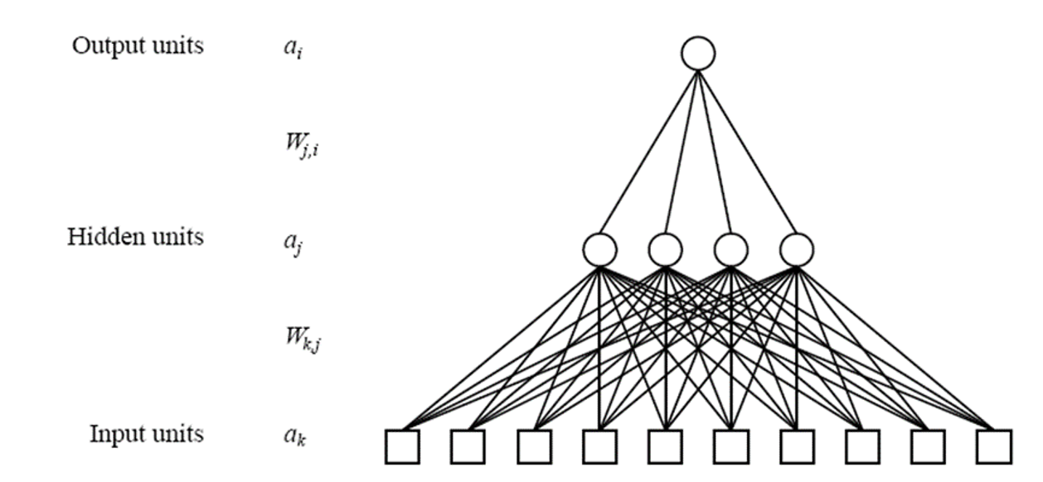
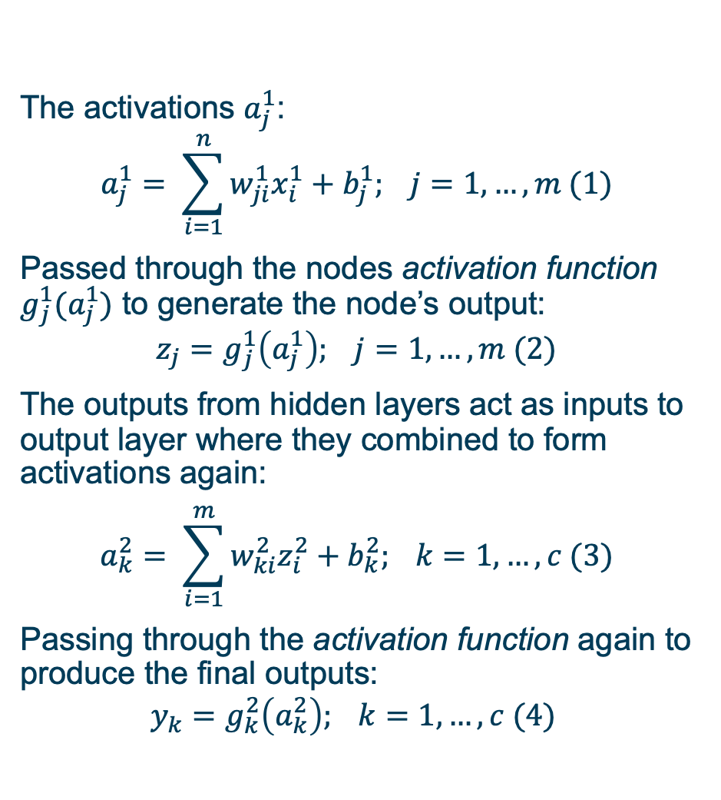
Multi-Layer Perceptron
The activations $a_{j}^{1}$:
$$a_{j}^{1}= \sum_{i=1}^{n}{w_{ji}^{1}x_{i}^{1}}+b_{j}^{1}; j=1,…,m (1)$$
Passed through the nodes activation function $g_{j}^{1}(a_{j}^{1})$ to generate the node’s output:
$$z_{j}=g_{j}^{1}\left(a_{j}^{1}\right); j=1,…,m (2)$$
The outputs from hidden layers act as inputs to output layer where they combined to form activations again:
$$a_{k}^{2}= \sum_{i=1}^{m}{w_{ki}^{2}z_{i}^{2}}+b_{k}^{2}; k=1,…,c (3)$$
Passing through the activation function again to produce the final outputs:
$$y_{k}=g_{k}^{2}\left(a_{k}^{2}\right); k=1,…,c (4)$$

Slide 6
Packages and Load Dataset

Slide 7
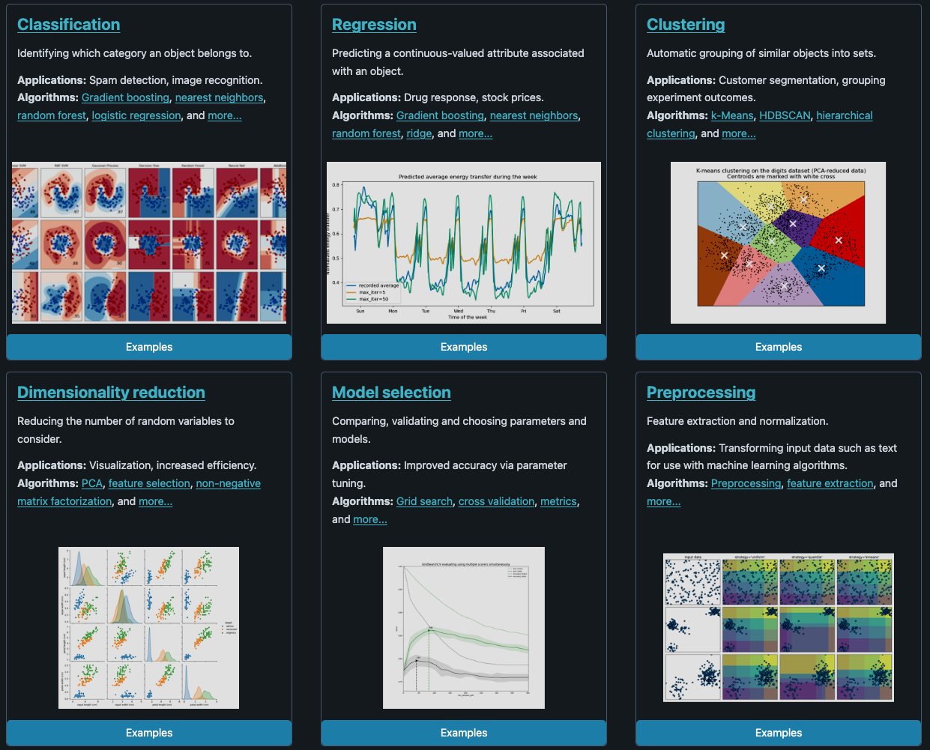
Package introduction: scikit-learn (sklearn)
The package for:
ML (such as, K-mean, Naive Bayes, Hierarchical Clustering, Stochastic Gradient Descent);
Dimensionality reduction (such as, PCA)
Model selection/processing (dataset splitting, cross-validation, regularization);
NN (MLP)
to archive prediction data analysis.
Source for MLP: https://scikit-learn.org/stable/modules/generated/sklearn.neural_network.MLPRegressor.html
Source for sklearn: https://scikit-learn.org/stable/index.html

Slide 8
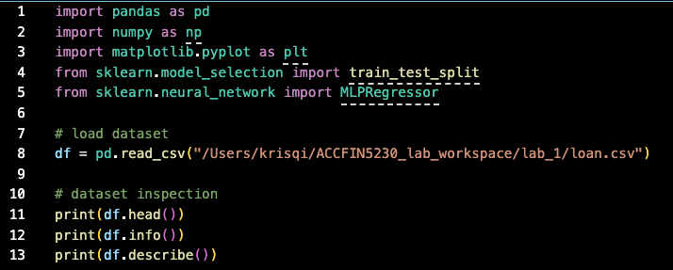
Import packages and load dataset with summary of descriptive statistics
Package load including:
Pandas for reading dataset and forming the dataframe in the future.
Numpy for basis compution.
From Sklearn.model_selection import train_test_split for the dataset split.
From Sklean.neural_network import MLPRegressor for design the MLP structure.
DataFrame is loaded by pd.read_csv(“file path”)
Inspection of dataset by:
.head() # default to show 5 index
.info() # showing the dshape, dtype, num_entries
.describe() # compute descriptive statistics

Slide 9
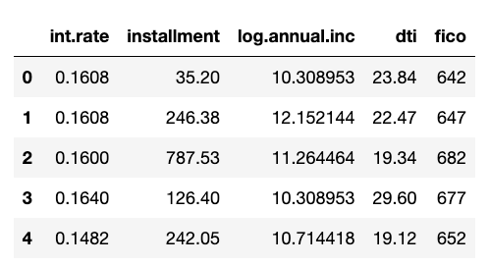
Import packages and load dataset Dataset explanation
Personal loan information to predict the credit scores.
Independent variables:
int.rate: The interest rate of the loan. Borrowers judged by LendingClub.com to be riskier are assigned higher interest rates.
installment: The monthly installments owed by the borrower if the loan is funded.
log.annual.inc: The natural log of the self-reported annual income of the borrower.
dti: The debt-to-income ratio of the borrower (amount of debt divided by annual income).
Dependent variable: fico (credit score of the borrower)

Slide 10
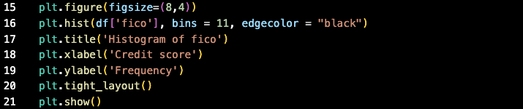
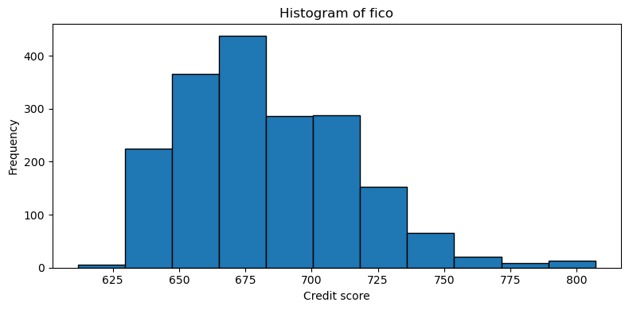
Import packages and load dataset Visualization (histogram) target dataset
.hist (dataset, bin number, colour) # build-in function to produce a histogram plot
.title # setting plot title
.xlabel # setting x-axis name
.ylabel # setting y-axis name
.show() # the function to show the plot

Slide 11
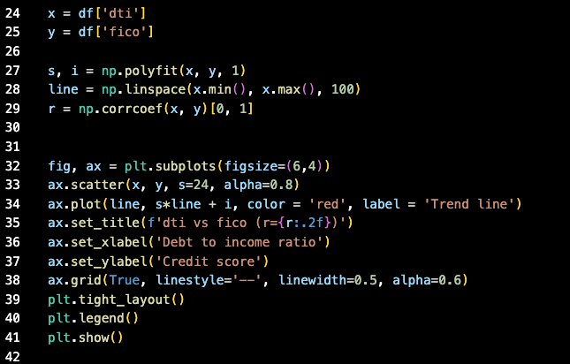
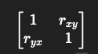
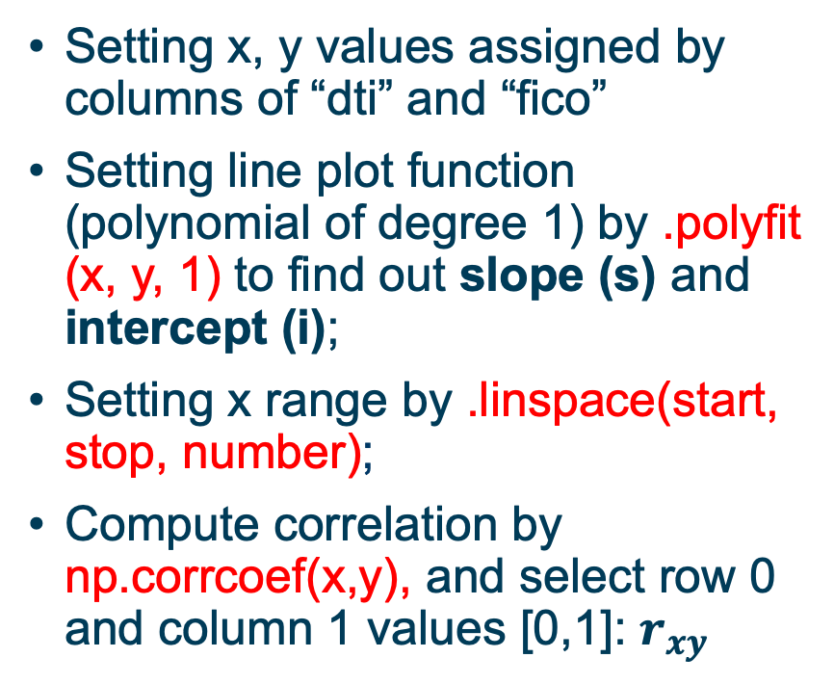
Import packages and load dataset Visualization (scatter) target dataset
Setting x, y values assigned by columns of “dti” and “fico”
Setting line plot function (polynomial of degree 1) by .polyfit (x, y, 1) to find out slope (s) and intercept (i);
Setting x range by .linspace(start, stop, number);
Compute correlation by np.corrcoef(x,y), and select row 0 and column 1 values [0,1]: $r_{xy}$

Slide 12
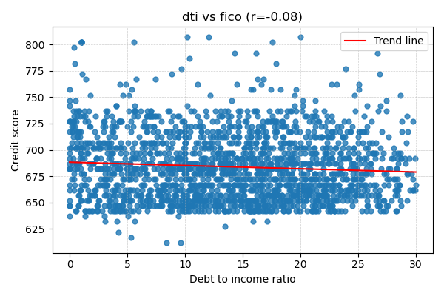
Import packages and load dataset Visualization (scatter) target dataset
.scatter (x, y, size of dot, alpha = transparence) # plot the blue scatters
.plot(x, y, color, legend) # plot a line

Slide 13
Preparation and Modeling

Slide 14
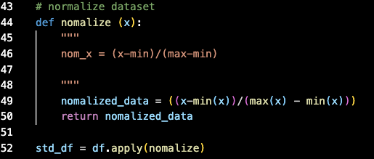
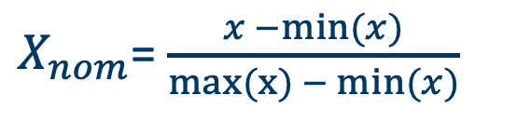
Preparation standardizing data
Neural networks work better when the data are standardized.
We standardized input variables. We also can use max-min technique to standardize data [0,1]:
def nomalize (x):
return ((x-min(x))/(max(x)-min(x)))
Apply the function to all date set, transforming the data set to standardized data set.
$X_{nom}$= $\frac{x −min⁡(x)}{max(x){− min⁡(x)}}$

Slide 15
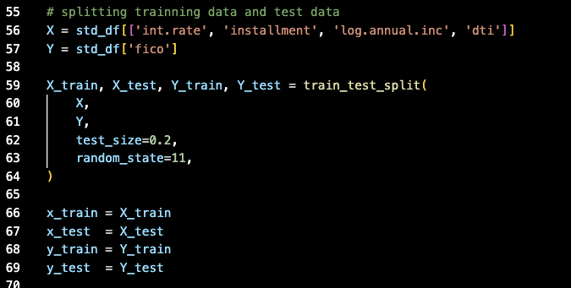
Preparation Splitting data for training and testing
Categorizing independent variable (int.rate, installment, log.annual.inc, dti) and dependent variable (fico)
Splitting data into x_train and y_train (80%); x_test and y_test (20%); random seed = 11

Slide 16
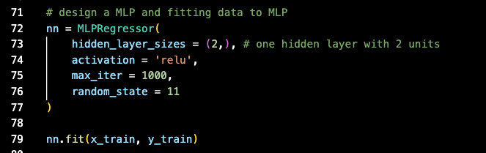
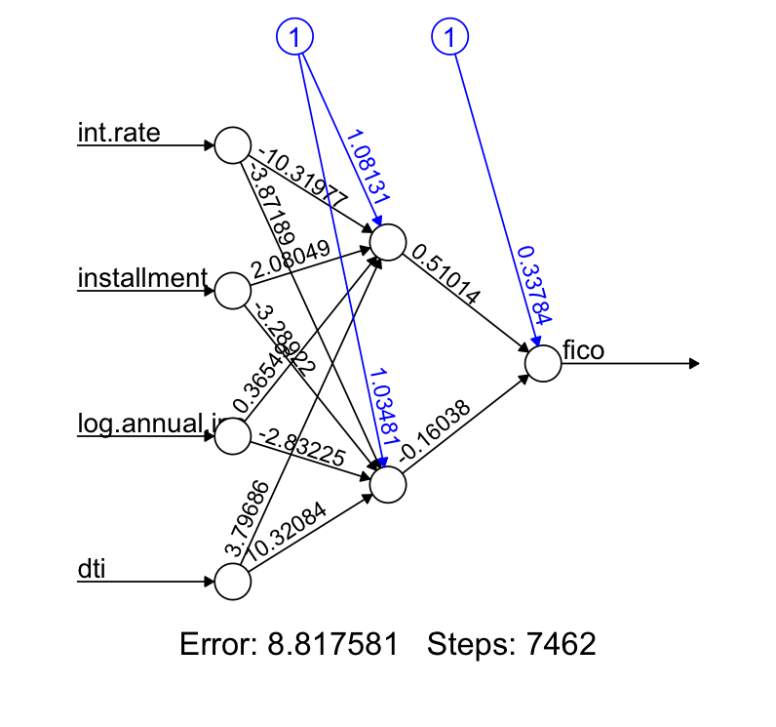
Fitting the model MLP structure design
MLPRegressor(
Hidden_layer_sizes = (2,),
# (n1, n2) means 2 hidden layers with n1 and n2 neurons
Activation = ‘relu’,
Max_iter = 1000,
Random_state = 11
)
Fitting model by x training data and y training data: nn.fit(x, y)

Slide 17
Prediction and Accuracy

Slide 18
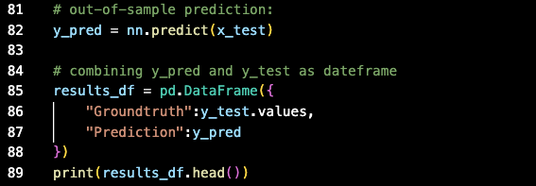
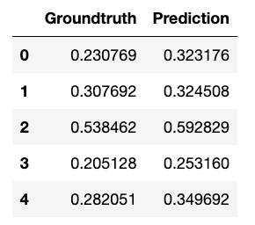
Out-of-sample prediction prediction
.predict() # using testing dataset to get the predicted result
Construct a new data frame for storage predicted result and original y testing data

Slide 19
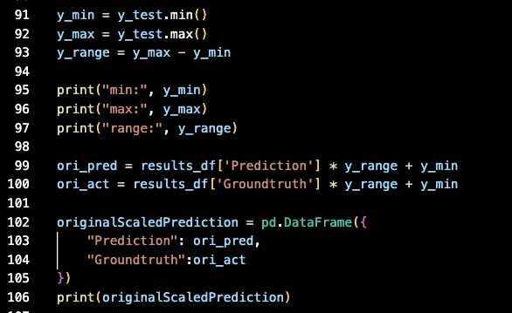
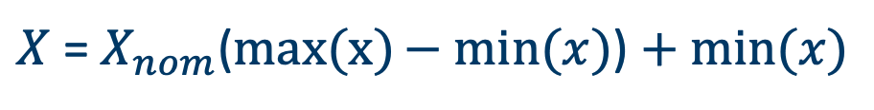
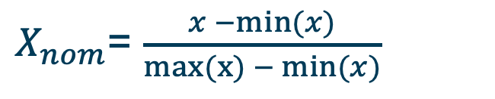
Transforming to Original Scale
Standardizing formula:
$X_{nom}$= $\frac{x −min⁡(x)}{max(x){− min⁡(x)}}$
Transforming back to original scale:
$X$ = $X_{nom}$($max(x){− min⁡(x)}$) $+ min⁡(x)$

Slide 20
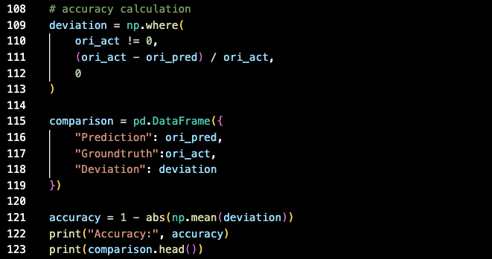
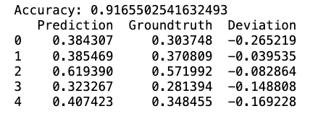
Accuracy
Handle with the denominator = 0 and compute the rate of deviation
Building a new dataframe for storage the comparison result of prediction, ground truth, and deviation.
Computing the accuracy rate by:
1- absolute value of mean of deviation

Slide 21

Thank you!

